Slide 1
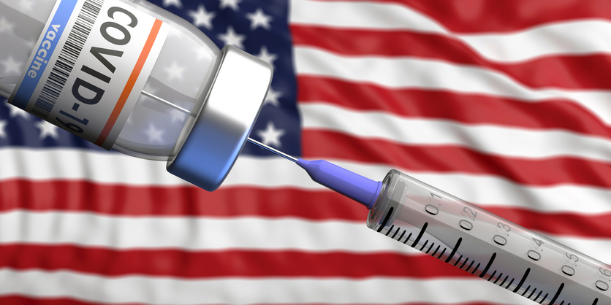
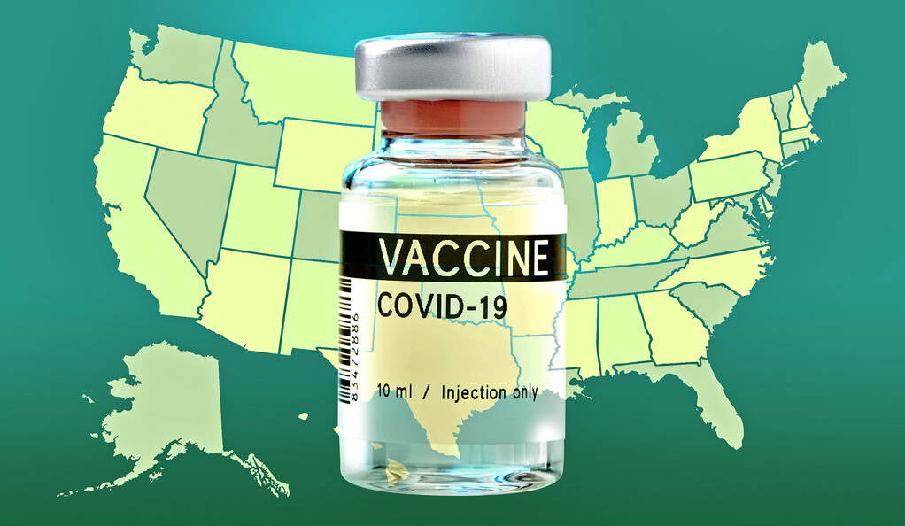
US Vaccine Tracker
Raven Thornton, Ramsha Zaman, Tania Guevara, Whitney Wong

Slide 2
Topic
Our project is to uncover patterns in population vaccinations in USA regarding region, percentage of administered dosages, age group, and distribution.

Slide 3
Questions
1. How many vaccine doses were administered per region?
2. Which region has the highest percent of doses administered (out of doses distributed)?
3. Which vaccine was distributed the most?
4. Which population according to age group has a higher percentage of people vaccinated?

Slide 4
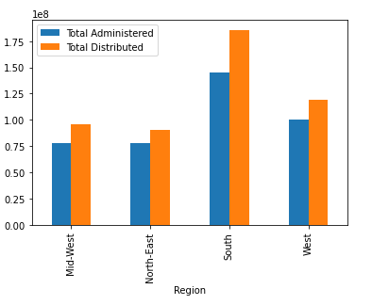
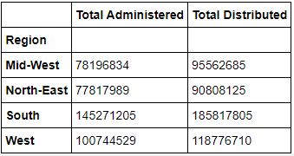
1. How many vaccine doses were administered per region?
Total Administrated and Distributed Vaccine in US

Slide 5
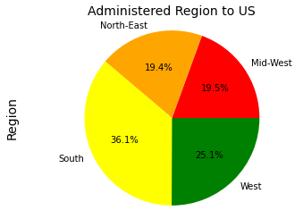
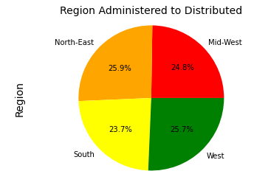
2. Which region has the highest percent of doses administered?

Slide 6
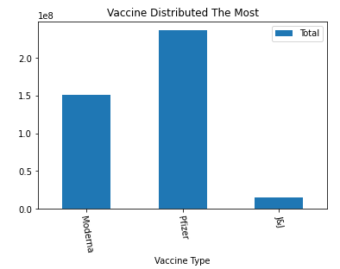
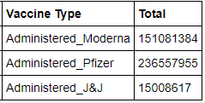
3. Which vaccine was distributed the most?

Slide 7
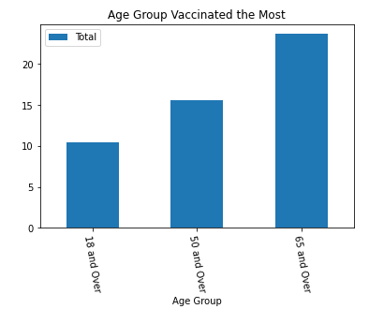
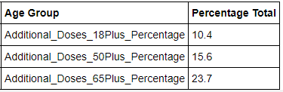
4. Which population according to age group has a higher percentage of people vaccinated?

Slide 9
Work Cited

Slide 10
“Eat healthy and do not forget to workout, this is going to build your immunity.”
- Daisy Shah

